Slide 1
Technical presentation
Companerobots

Slide 2
Features
01
02
03
04
Musicians controlled by our given gestures
Synchronization
Thanks to camera and raspberry pi, we can command robots to play in different tempo, and different sounds not only by code but also by out gestures
Each robot is synchronized by esp-now with the main “server”, the raspberry pi. That gives him almost realtime updates about stage and tells him how to react to upcoming events.
Visual and sound effects
Camera controlling dancer
The robots actually plays on the instruments, not only move randomly with their hands and play the songs on loudspeakers
The dancer robot can copy your movements with his mechanical parts. Of course only if you are in front of the camera which communicates with it.

Slide 3
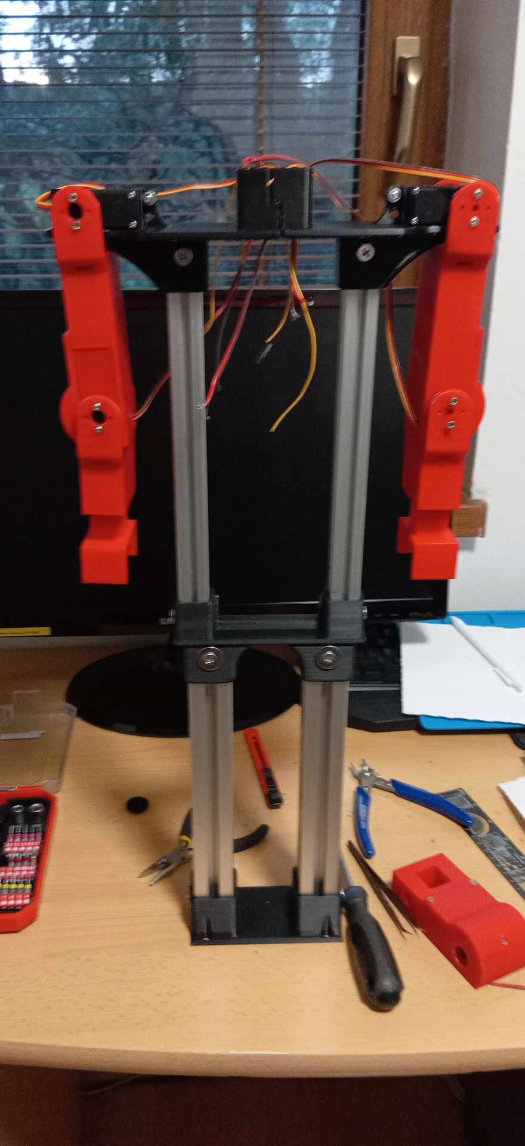
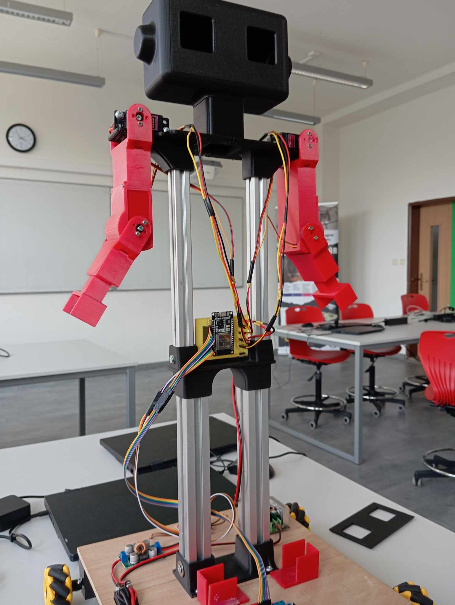
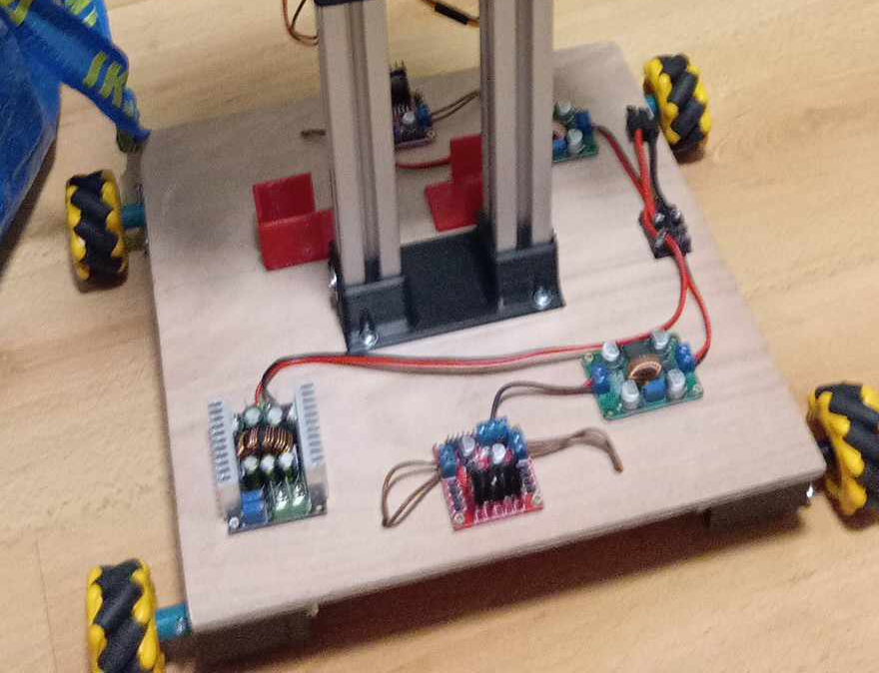
Dancer
3D printed parts
mg996 servos
ESP32
motors
step up converters
3D printed battery holder
motor drivers
motor driver

